Slide 1
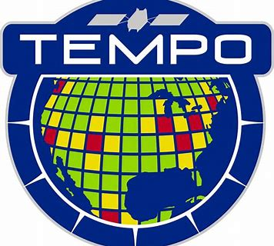



Ozone in the 21st Century:
It’s not your Grandmother’s Ozone Anymore!
Jack Fishman and Jason Welsh
Department of Earth and Atmospheric Sciences
Saint Louis University
St. Louis MO
Presented at TEMPO Science Team Meeting
Boulder, CO
June 6, 2018

Slide 2
Overview
• One impetus for the formation of National Ambient Air Quality Standards was the extremely high concentrations of ozone found in urban areas in the 1960’s. Because of our increased understanding of ozone photochemistry and the use of emission controls on ozone precursors, today’s concentrations are considerably lower, especially in urban areas.
• Using a regional scale photochemical transport model, we are able to simulate an air pollution episode over the St. Louis region. The calculated distribution and quantity of model generated ozone agrees will with observations and we compare the calculated surface ozone with integrated quantities – the general type of measurement that should be attainable by TEMPO.
• Comparing this calculated distribution with what had been seen in two widespread pollution episodes in 1980 and 1988, respectively, we infer that the amount of ozone in our St. Louis simulation is much less than what was present in the 1980’s.
• The simplified concept of ozone can be divided into three types: Good, Bad, and Ugly Ozone. Consistent with the previous paradigm, the “Good” ozone is the ozone in the stratosphere, where it protects life from harmful ultraviolet radiation; the ugly ozone is the ozone found in the urban atmosphere; and the bad ozone is ozone in the free troposphere, which is increasing, consistent with the increase of carbon dioxide. This ozone impacts climate and crops growth and vegetation in nonurban areas.
• The global increase in this “bad” ozone reflects the new issues that make it imperative that we make global tropospheric measurements, rather than for air quality purposes.

Slide 3
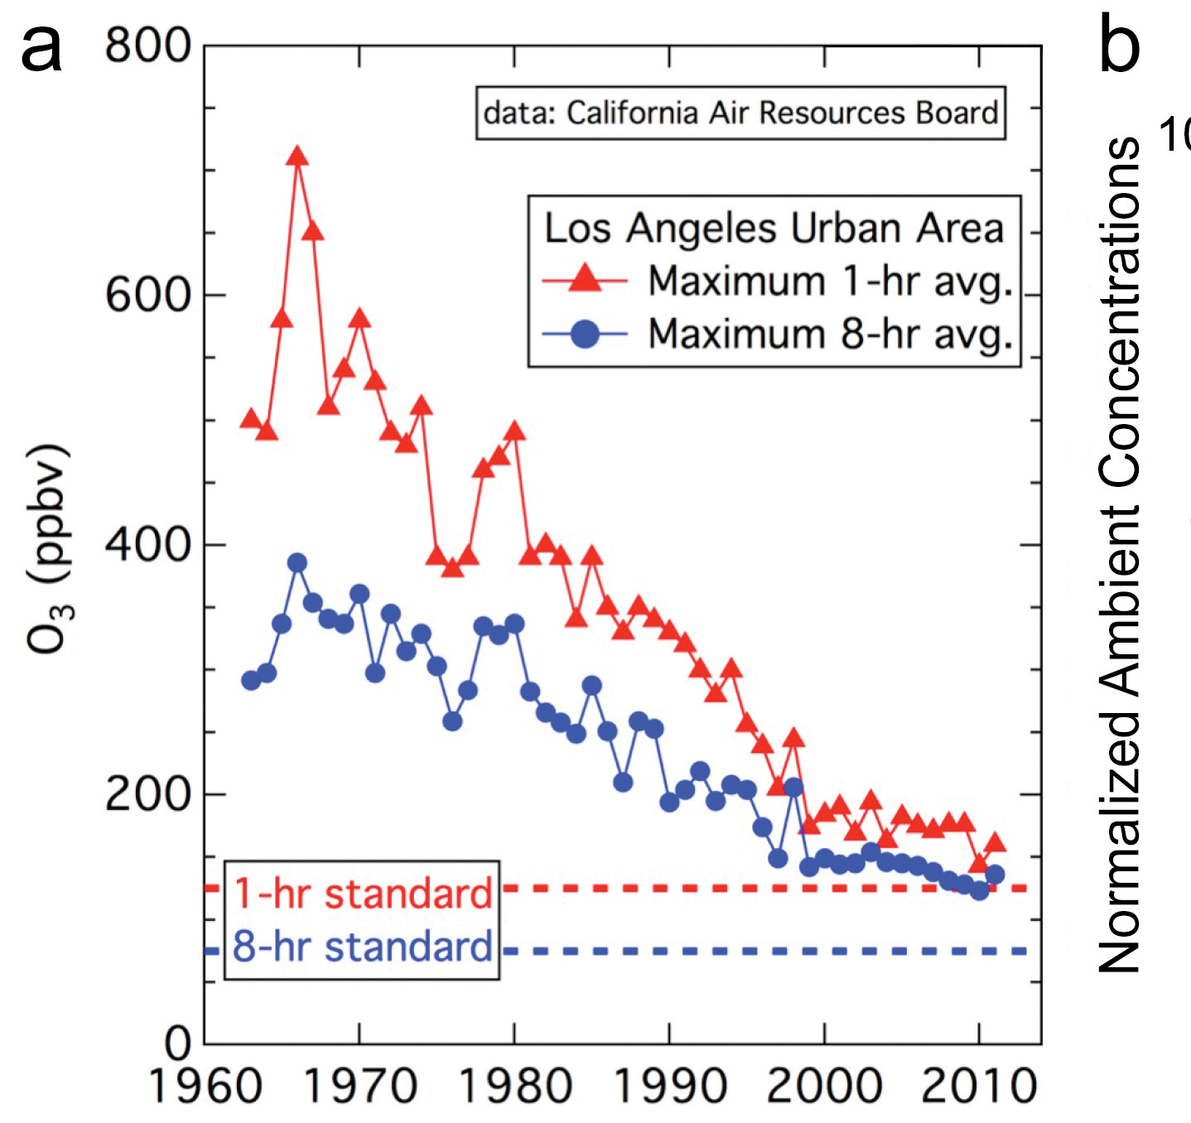
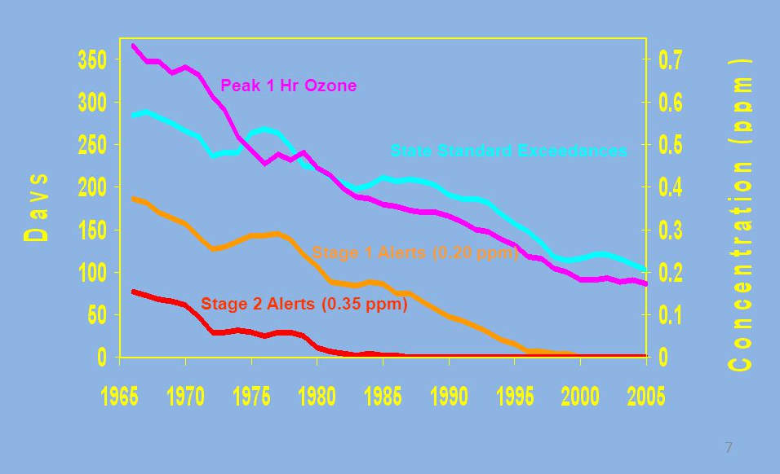
Because of Pollution Controls, Urban Ozone Levels are Much Lower than they were 50 Years Ago
Los Angeles: The Days of 1st and 2nd Stage Ozone Alerts are Now History

Slide 4
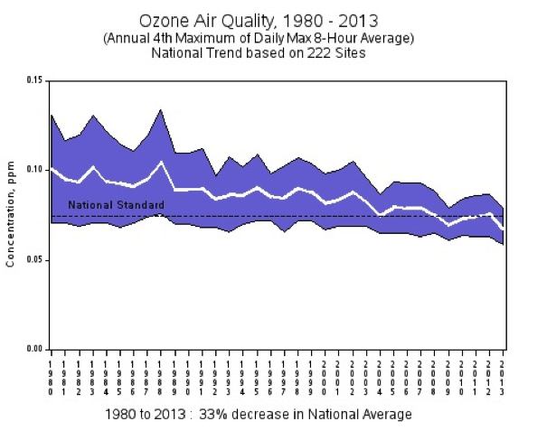
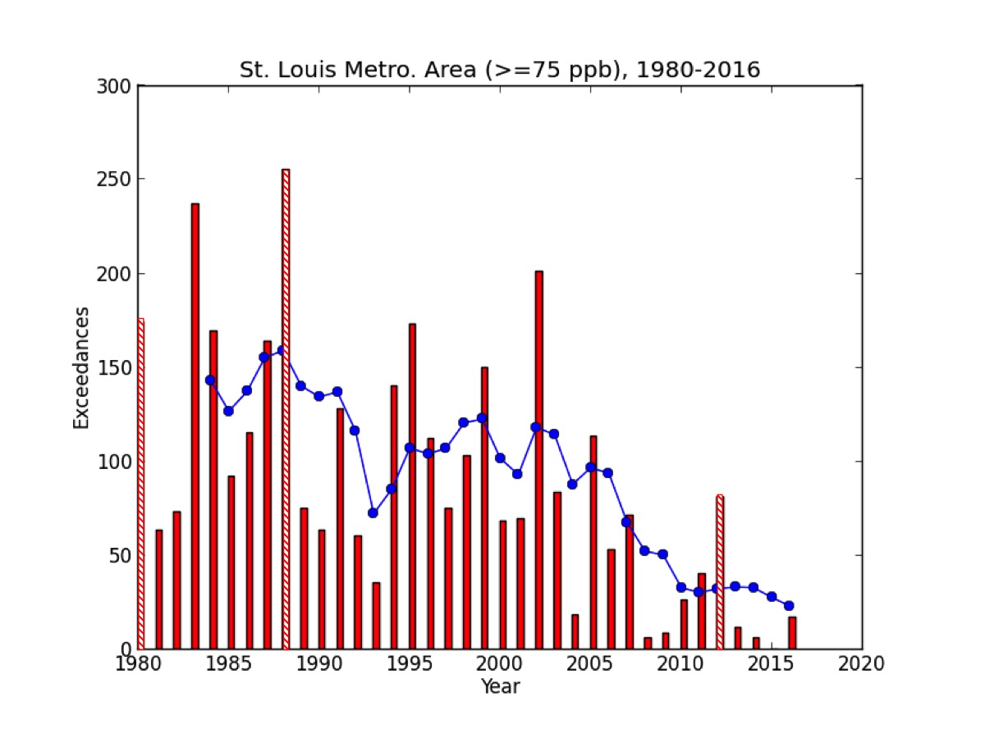
National Trends and Trends in St. Louis Show Similar Declines

Slide 5
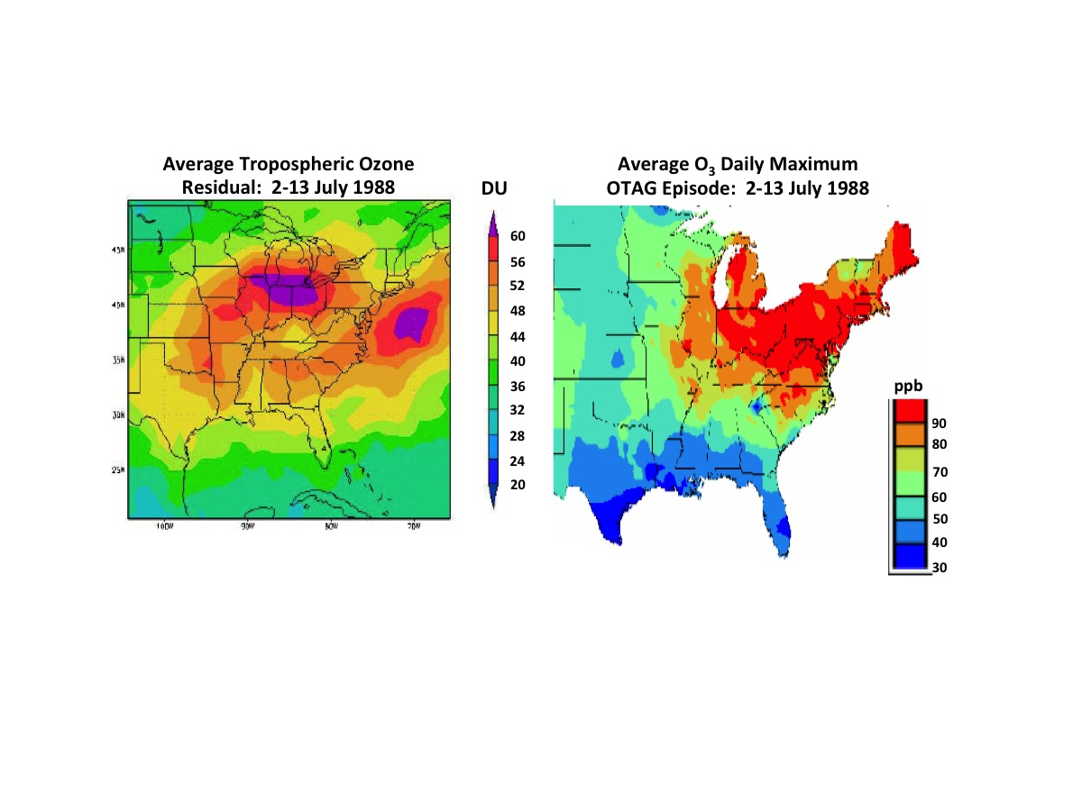
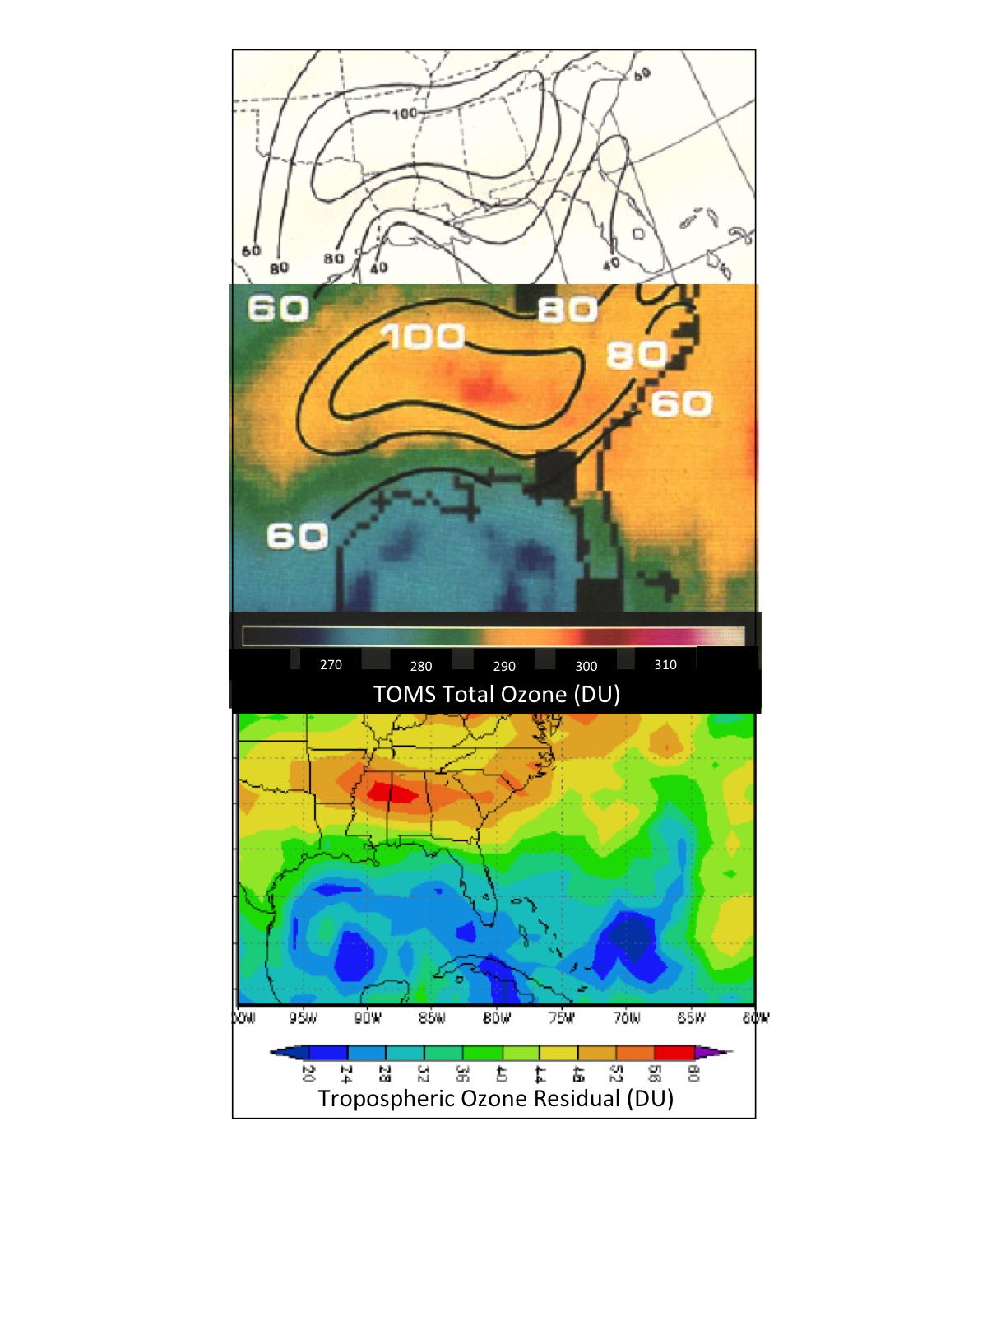
Do Massive Air Pollution Events like those seen in the 1980s still exist?
Massive Synoptic Scale Ozone Episodes in 1980s are No Longer
Massive Synoptic Scale Ozone Episodes in 1980s are No Longer
Massive Synoptic Scale Ozone Episodes in 1980s are No Longer
Massive Synoptic Scale Ozone Episodes in 1980s are No Longer
Earlier Studies of Fishman et al. (1987; J. Clim. Appl. Meteor., 26, 1638-1654) have identified massive air pollution episodes that were identified using TOMS data. The air pollution episode of 1988 led to the formation of a new task force to investigate the origin of such massive events and the publication of the NAS report Rethinking the Ozone Problem, which led to the strategy of reducing NO_{x} emissions to curb the formation of these synoptic scale events.
Earlier Studies of Fishman et al. (1987; J. Clim. Appl. Meteor., 26, 1638-1654) have identified massive air pollution episodes that were identified using TOMS data. The air pollution episode of 1988 led to the formation of a new task force to investigate the origin of such massive events and the publication of the NAS report Rethinking the Ozone Problem, which led to the strategy of reducing NO_{x} emissions to curb the formation of these synoptic scale events.
Earlier Studies of Fishman et al. (1987; J. Clim. Appl. Meteor., 26, 1638-1654) have identified massive air pollution episodes that were identified using TOMS data. The air pollution episode of 1988 led to the formation of a new task force to investigate the origin of such massive events and the publication of the NAS report Rethinking the Ozone Problem, which led to the strategy of reducing NO_{x} emissions to curb the formation of these synoptic scale events.
Do Massive Air Pollution Events like those seen in the 1980s still exist?
Do Massive Air Pollution Events like those seen in the 1980s still exist?

Slide 6
Do Massive Air Pollution Events like those seen in the 1980s still exist?
2012
July 2 – Day for Model Results
June 27 – Most Polluted Day

Slide 7
Do Massive Air Pollution Events like those seen in the 1980s still exist?
2013
2014

Slide 8
Do Massive Air Pollution Events like those seen in the 1980s still exist?
2015
2016
2017
2018 (through May)

Slide 9
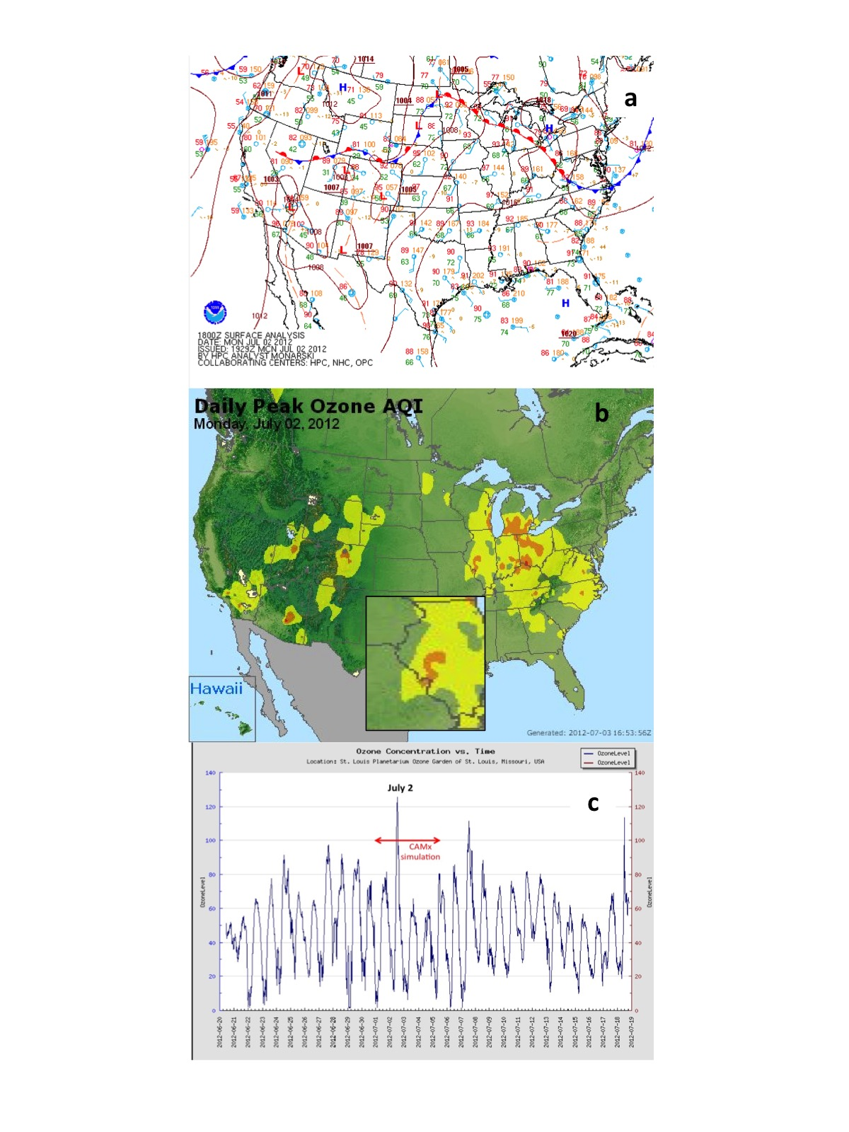
Simulation of July 2012 Air Pollution Episode Using a Regional-Scale Photochemical Transport Model*
Model Run Time

Slide 10
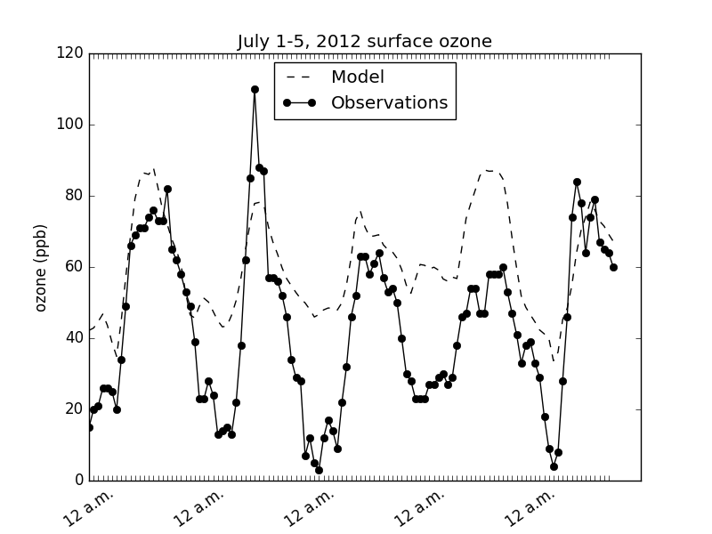
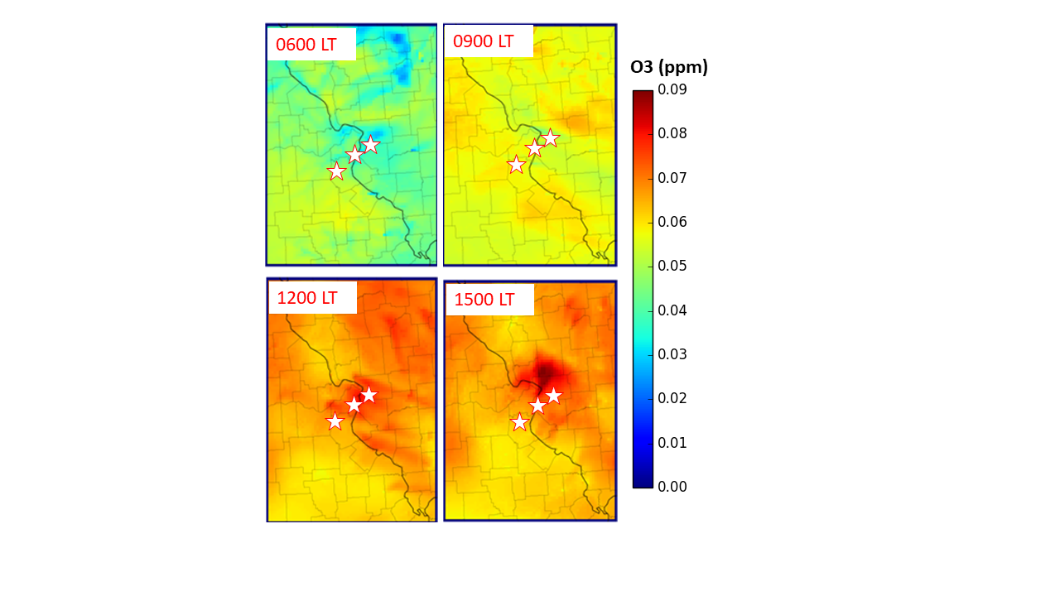
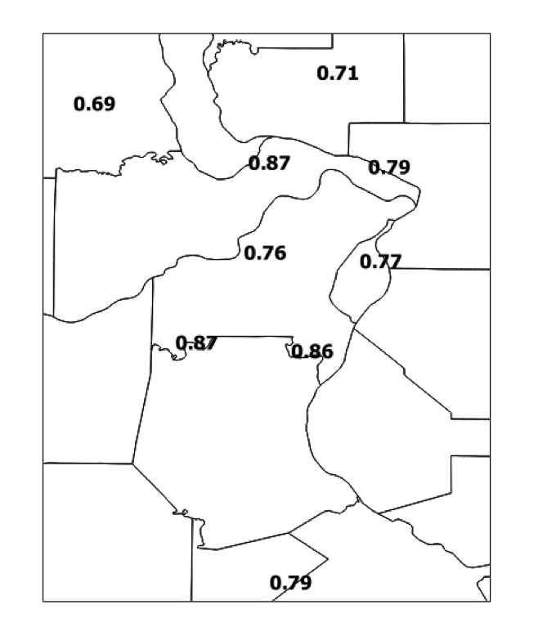
Surface Ozone Model Results

Slide 11
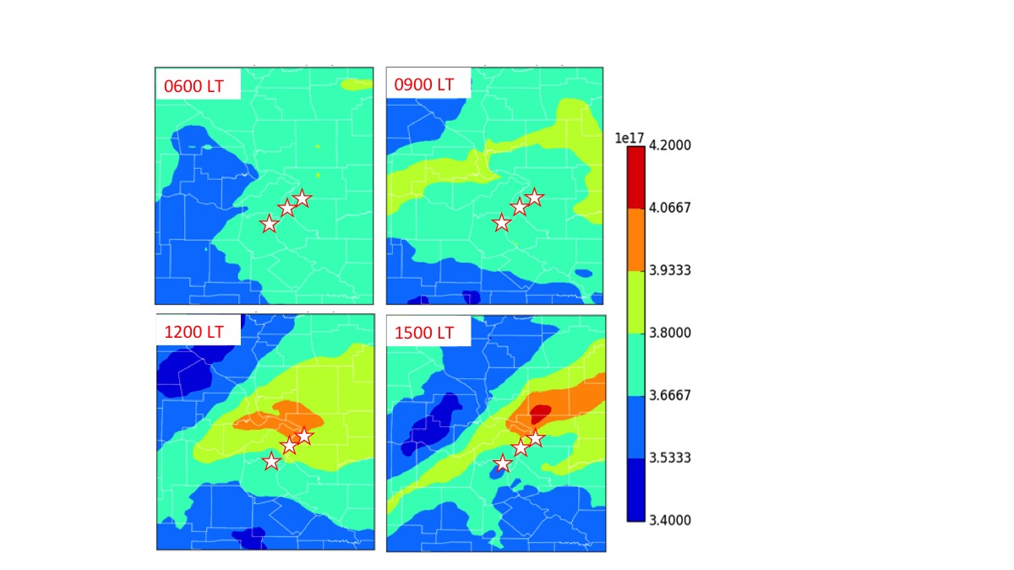
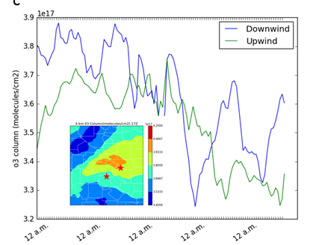
Integrated Ozone Model Results

Slide 12
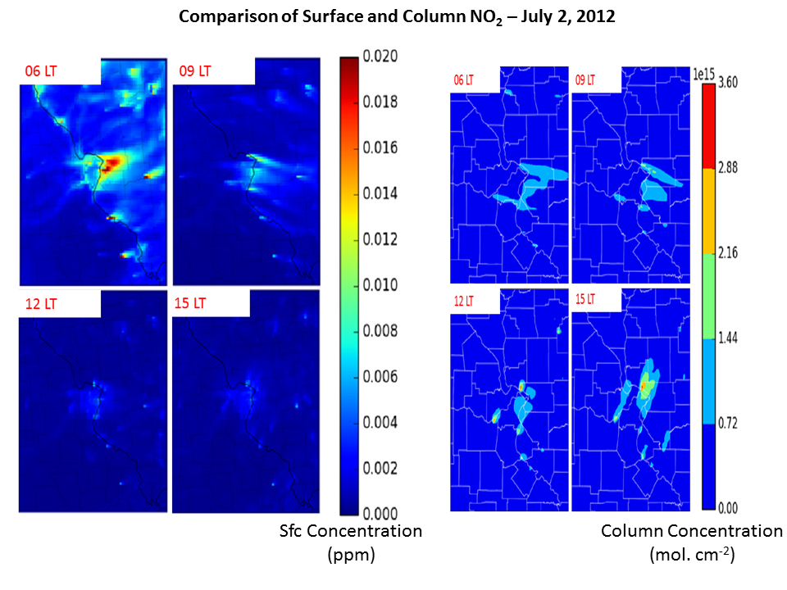
Model Results for NO₂

Slide 13
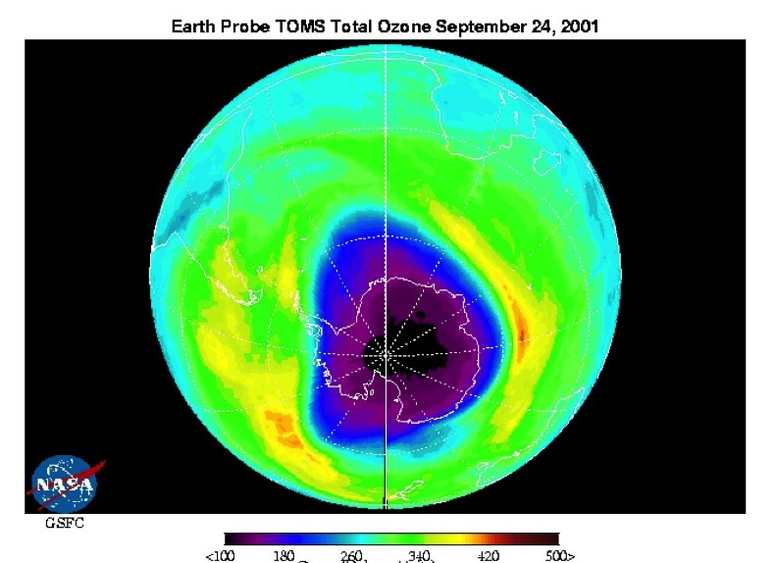
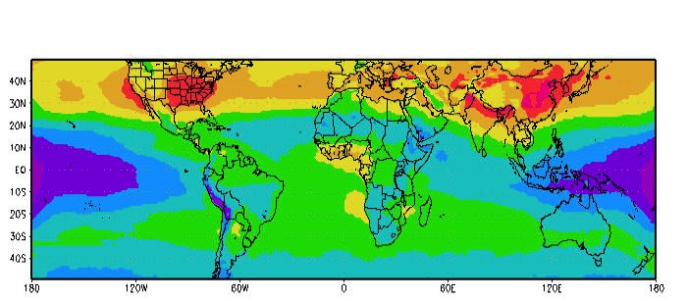
Ozone in the Anthropocene:
Good, Bad, and Ugly
Bad ozone in nonurban areas is still increasing and is damaging plants trees and crops
Many countries have found a way to reduce the ugly ozone in urban areas
Depletion of the good ozone in the stratosphere has been reversed

Slide 14
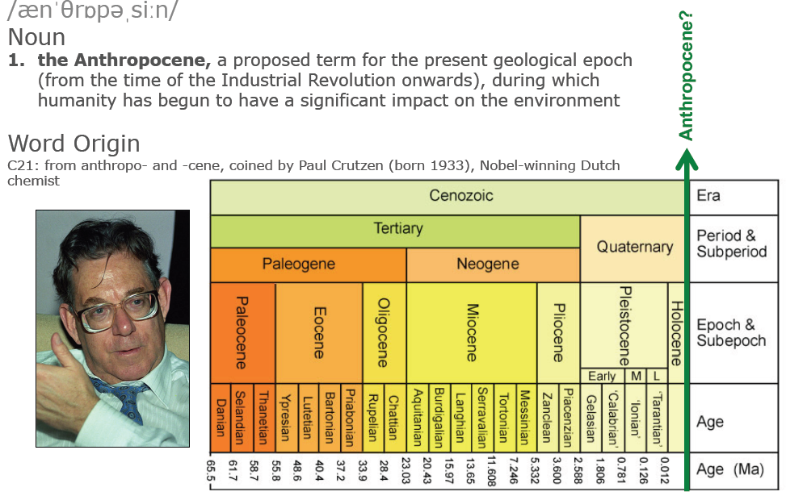
The Anthropocene: Humankind as a Geologic Force

Slide 17
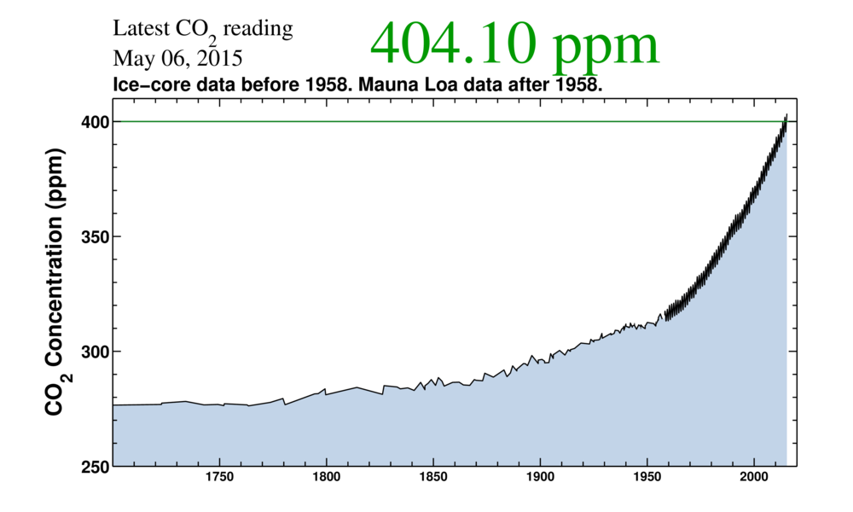

Slide 18
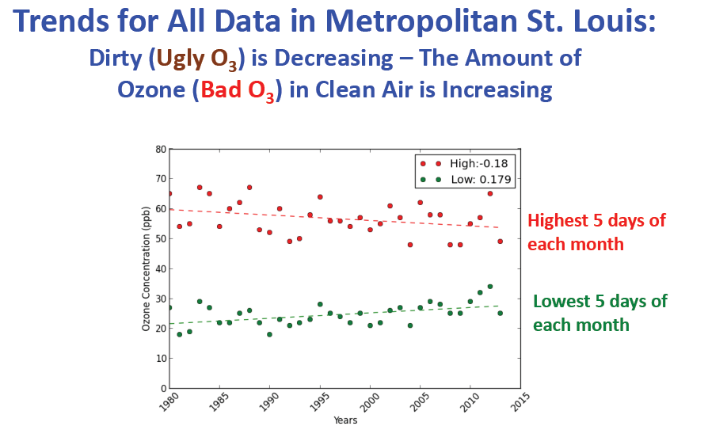
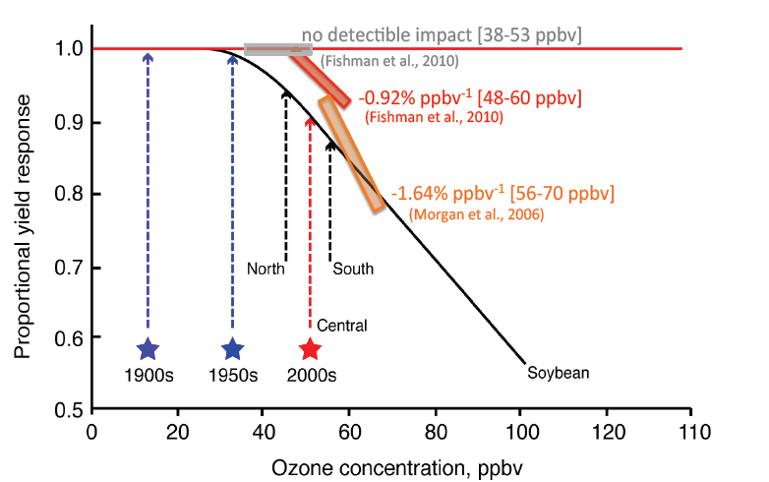
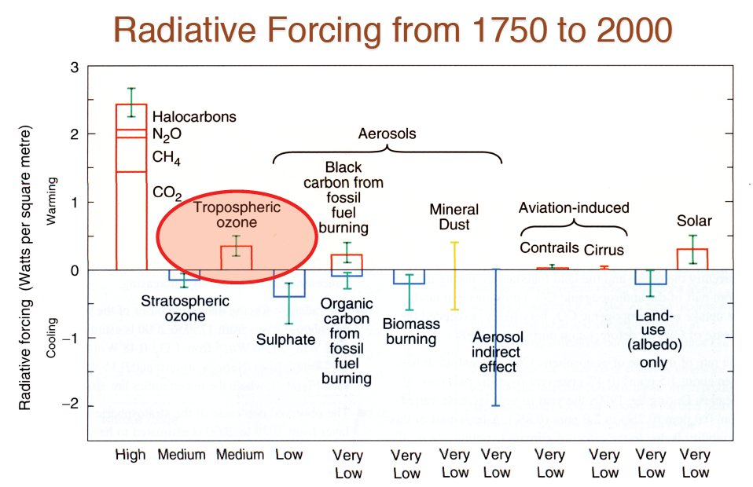
Dirty Air is Getting Cleaner – Clean Air is Getting Dirtier
Analysis of data from St. Louis that segregates the cleanest days of the month from the most polluted ones show that there is an increasing trend in the clean data but a decreasing trend in the more polluted measurements. Because of this secular increase, nonurban areas where crops are grown (e.g., in the midwestern U.S.) now see concentrations that impact crop growth (as shown in the middle panel). The background tropospheric ozone is also a major contributor to global warming, as illustrated in the last panel, as discussed in Fishman et al. (2010; Atmos. Environ., 85, 1171-1176.

Slide 19
Summary
• The extremely unhealthy air of the 1950s and 1960s in urban areas is now a thing of the past because of emissions regulations enacted after the passage implementation of the Clean Air Act of 1970. An analysis of the AirNow data suggests that synoptic-scale massive pollution episodes identified through some of the early satellite studies are no longer present.
• Conducting a simulation of an air pollution episode in St. Louis during July 2012 produced a reasonably good simulation of the available observations. However, the magnitude of the amount of ozone produced from this model study suggests that the enhanced amount of ozone is on the order of 2-3 DU, an increase much lower than what had been observed in two synoptic-scale episodes, which showed an enhance of 10-15 DU over a much larger area.
• Connected to the emergence of the Anthropocene, background tropospheric ozone concentrations are still increasing and will pose a threat to crop production, which will exasperate the damage to crops from increased temperatures and new precipitation patterns.
• In this new paradigm of “good, bad, and ugly” ozone, focus on “bad” tropospheric ozone as a greenhouse gas and as a threat to food security may become a more important issue than urban air quality.

